Slide 1
Finding Significant Items in Data Streams
Tong Yang, Haowei Zhang
Dongsheng Yang, Yucheng Huang, Xiaoming Li
Peking University, China
Haowei Zhang, Peking University
haowei.zhang@pku.com
Notes:
Good afternoon, everyone. My name is Haowei Zhang. I am an undergraduated student from Peking University. It's my honor to give a presentation in ICDE.
Today my topic is ``Finding significant Items in Data Streams’’.

Slide 2
Outline
PART 01
Background
PART 02
Significant Items
PART 03
Related work
PART 04
Long-tail Clock (LTC)
PART 05
Optimizations
PART 06
Experimental results
PART 07
Conclusion
Notes:
Here is the outline, and we first introduce the background.

Slide 3
01
PART ONE
Background
Notes:
First, we introduce the background.

Slide 4
01
Background
Motivations
Exploding data provides more opportunities for users to better understand the world.
It is hard for users to find the information they care about most in time.
Best solution: approximate data strcutures
Few errors don't influence the results.
Fast and memory efficient.
Notes:
As we can see, nowadays, the exploding data provides more opportunities for users to better understand the world. But unfortunately, it is hard for users to find the information they care about most in time. The best solution for solving this problem is using approximate data structures because of the following reasons: First, as long as the data structure is accurate enough, or in other words, it causes few errors, it almost doesn’t influence the results. For example, when we want to find feature values in machine learning, we don’t care whether the feature values are all useful, but we hope that the number of useful feature values to be as many as possible. Second, approximate data structures are often fast and memory efficient. In recent decades, a series of approximate data structures have been proposed and played important roles, including the Bloom filter, sketches and many others.

Slide 5
02
PART TWO
Significant Items
Notes:
Next, let me explain the topic, the main problem is that what the significant items are.

Slide 6
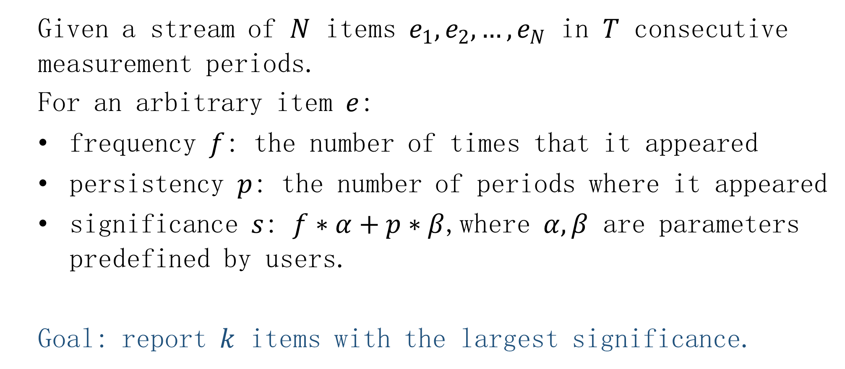
02
Significant Items---Definition
Given a stream of $N$ items $e_{1},e_{2}, …, e_{N}$ in $T$ consecutive measurement periods.
For an arbitrary item $e$:
frequency $f$: the number of times that it appeared
persistency $p$: the number of periods where it appeared
significance $s$: $f∗α+p∗β$,where $α,β$ are parameters predefined by users.
Goal: report $k$ items with the largest significance.
Notes:
The definition of significant items are shown in this slide: given a stream of N items in T consecutive measurement periods. For an arbitrary item e, its frequency f is defined as the number of times that it appeared, its persistency p is defined as the number of periods where it appeared, and its significance s is defined as a function: f multiplies alpha plus p multiplies beta, where alpha and beta are parameters predefined by users. The goal of this paper is to report k items with the largest significance.

Slide 7


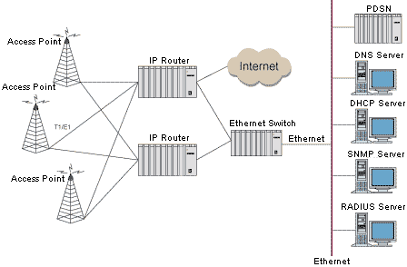
02
Significant Items---User cases
DDoS attacks detection
Website evaluation
Network congestion
Notes:
Next I’ll show three user cases to prove that finding significant items is a key component in many applications.
First: DDoS attacks detection. The DDoS victim receives many packets from attackers, which could be detected by finding frequent items. But checking all frequent items are time-consuming. Actually, the attack traffic is often not only frequent but also persistent. Therefore, finding significant items could somehow separate attack traffic from normal traffic more accurately.
Second, website evaluation. For a website, the frequency refers to the number of user’s accesses to it, and the persistency indicates whether this website is popular all the time. So, using significance to evaluate a website is convincing.
Third, network congestion. it happens every second in data centers. One effective solution is to change the forwarding paths of frequent flows, however, some algorithms for organizing the forwarding table do not support fast update. Therefore, it is desirable to change as few flow paths as possible. However, many flows could be a burst, so changing the forwarding entry of frequent flows is not always useful. A better choice is to find significant flows. Because with a high probability they are frequent in a long period later.

Slide 8
03
PART THREE
Related work
Notes:
Next, we present the third part --related work

Slide 9
03
Related work
No prior work could deal with finding significant items.
Frequent items
Persistent items
Sketch-based: the CM sketch, the CU sketch
Counter-based: CSS, Space Saving, Lossy Counting
Sketch-based using a bloom filter: the CM sketch, the CU sketch
PIE and its variant
Limitations: low memory efficient, inaccurate
Notes:
To the best of our knowledge, no prior work could deal with finding significant items. A straightforward solution is to combine two data structures: one for finding frequent items and the other for finding persistent items. Existing algorithms for finding frequent items could be divided into two categories: sketch-based and counter-based. The sketch-based category includes the CM sketch and the CU sketch. The counter-based category includes CSS, Space Saving, and Lossy Counting. For finding persistent items, the key problem is that the estimated persistency of an item should be incremented at most 1 even if it appeared several times in a period. So, the straightforward solution is to use a counting bloom filter to judge whether this item has appeared before in the current period and use a sketch-based data structure to record its estimated persistency. In VLDB 2017, the algorithm PIE was proposed, it uses T data structures to record information, where T is the number of periods. However, all the existing data structures have the following limitations: they are low memory efficient. As a result, they are inaccurate in the situation of tight memory size.

Slide 10
04
PART FOUR
Long-tail Clock (LTC)
Notes:
Next, we present out solution – Long-tail Clock, or LTC in short.

Slide 11
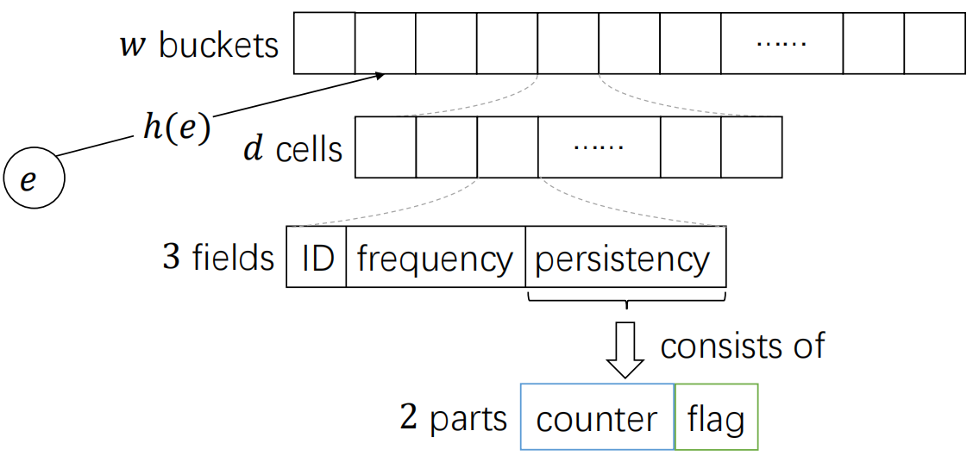
04
LTC---Data structure
For the recorded item
frequency: estimated frequency
counter: estimated persistency
flag: whether it has appeared in the current period
Notes:
First we present our data structure. It is a lossy table, consists of w buckets. Every bucket consists of d cells. And every cell consists of three fields: ID, frequency and persistency. The persistency fields consists of two parts: a counter and a flag. The ID filed records an item’s ID, the frequency field records the estimated frequency of that item. the counter part records the estimated persistency of that item, and the flag denotes whether this item has appeared in the current period. Using these fields, we can easily calculate the estimated significance of recorded items. When an item arrives, first it will be mapped to a bucket by a hash function.

Slide 12
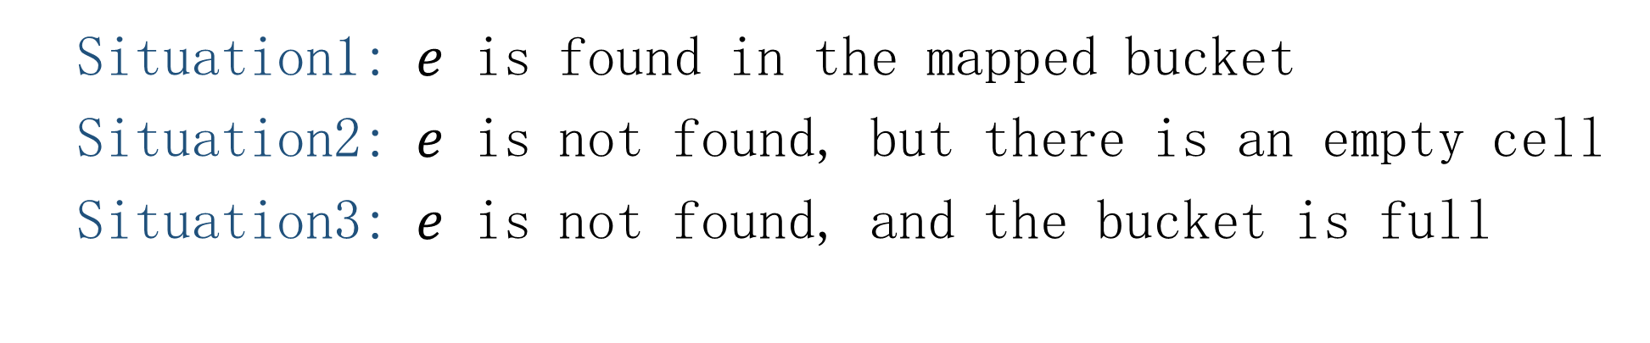
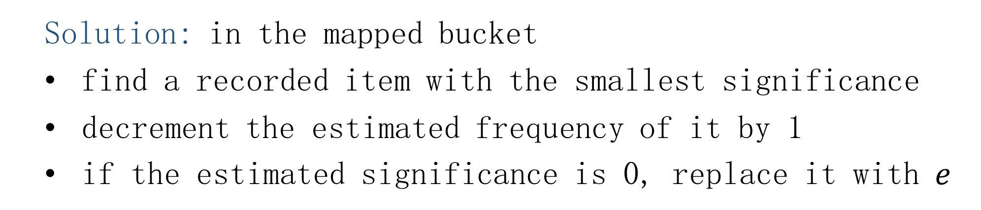
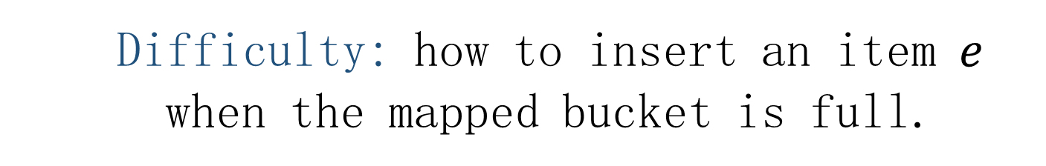
04
LTC---Insertion (update frequency)
Difficulty: how to insert an item $e$ when the mapped bucket is full.
Situation1: $e$ is found in the mapped bucket
Situation2: $e$ is not found, but there is an empty cell
Situation3: $e$ is not found, and the bucket is full
Solution: in the mapped bucket
find a recorded item with the smallest significance
decrement the estimated frequency of it by 1
if the estimated significance is 0, replace it with $e$
Notes:
Note the situation we discuss is the memory size is tight. So we can’t record all items’ information. So when an item is mapped to a bucket. There are three cases. First, it could be found in that bucket. Apparently, we just need to increment the estimated frequency by 1. Second, we can’t find it in that bucket but there is an empty cell. Easily, we just need to set the estimated frequency to 1. The difficult point is the third situation: we can’t find it in that bucket and the mapped bucket is full. Discarding this item is not a good choice. Here is our solution: in the mapped bucket, we first find a recorded item with the smallest estimated significance. and then we decrement the estimated frequency of this item by 1. If the estimated significance of that item is 0, we replace it with the arriving item. In this way, for any time, the arriving item has a chance to be inserted into our data structure.

Slide 13
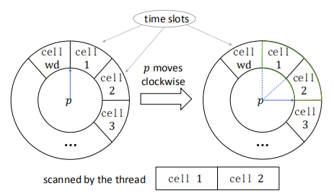
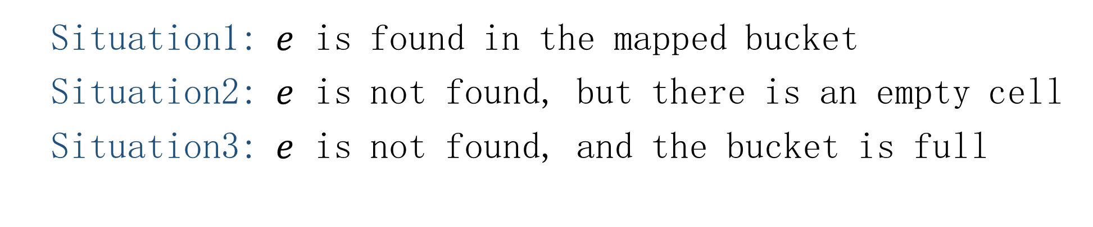

04
LTC---Insertion (update persistency)
Difficulty: how to update the counter
When an item arrives, we set the flag to true.
When a time slot is scanned by the pointer, we update the corresponding cell’s counter.
Every cell corresponds to a time slot.
A pointer $p$ moves clockwise and passes several slots for every insertion.
The time of passing all slots is equal to the length of that period.
Solution: using Clock
Situation1: $e$ is found in the mapped bucket
Situation2: $e$ is not found, but there is an empty cell
Situation3: $e$ is not found, and the bucket is full
Notes:
The strategy of updating persistency in the third case is similar: decrementing the most insignificant item’s estimated persistency by 1. And if the estimated significance of that item is 0, we replace it with the arriving item. However, the difficult point of updating persistency is that during one period, we can only increment the counter of an item at most 1 even if it appeared several times. To deal with this problem, we leverage the spirit of a well-known algorithm: Clock. As shown in the slide, every cell corresponds to a time slot in the Clock. A pointer p moves clockwise and passes several slots for every insertion. The time of passing all slots is equal to the length of that period. To guarantee it, we just need to set the speed of p appropriately. when an item arrives, if we find it in a cell, we just set the flag to true, which denotes this item has appeared in the current period. Furthermore, we use another thread to scan all time slots which are passed by the pointer p, and update the corresponding cells’ counter: if the flag is true, we increment its counter and reset the flag to false, otherwise we do nothing. In this way, it is guaranteed that every counter is incremented at most once in a period, since its corresponding time slot is scanned exactly once in one period.

Slide 14
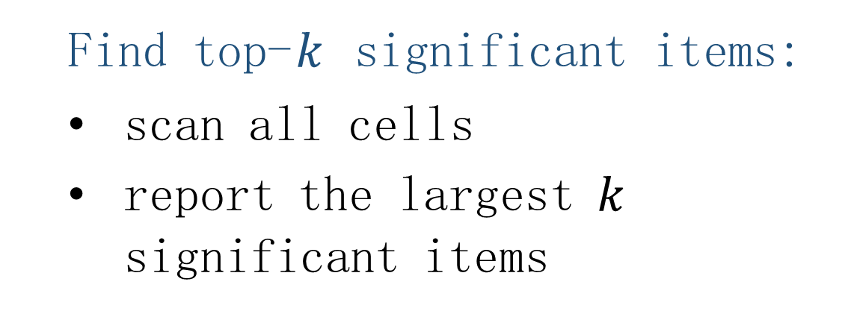
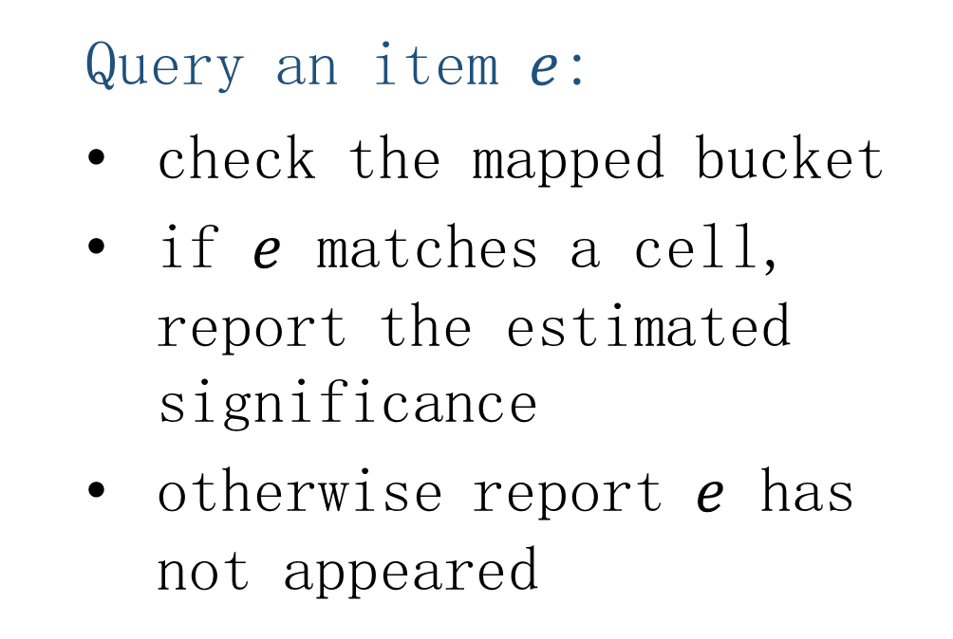
04
LTC---Query
Query an item $e$:
check the mapped bucket
if $e$ matches a cell, report the estimated significance
otherwise report $e$ has not appeared
Find top-$k$ significant items:
scan all cells
report the largest $k$ significant items
Notes:
Next we show the operation of query.
When users want to query the significance of an item e. We first check the mapped bucket, if e matches a cell, we report its estimated significance, otherwise we report that e has not appeared.
When users want to find top-k significant items. We just need to scan all cells and report the largest k significant items.

Slide 15
05
PART FIVE
Optimizations
Notes:
Next, we present two optimizations of our data structure.

Slide 16
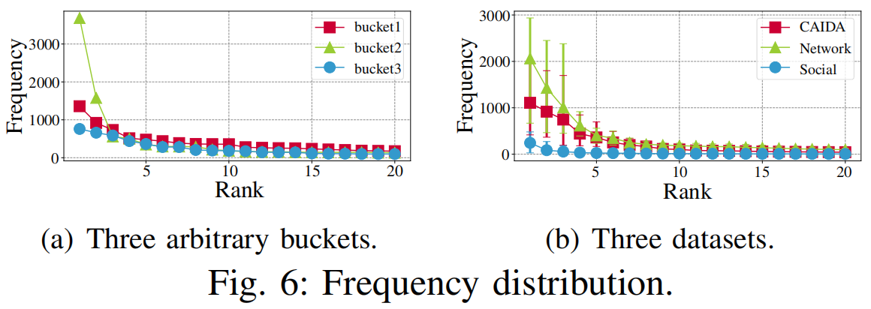
05
Optimizations---Long-tail Replacement
Assumption:
Real datasets often follow the long-tail distribution, and frequencies of items that fall into the same bucket still follow long-tail distribution.
Notes:
Next we show the optimization of long-tail replacement.
This optimization is based on this assumption, which is shown in the slide: real datasets often follow the long-tail distribution, and frequencies of items that fall into the same bucket still follow long-tail distribution.
We also conduct experiments to prove this assumption, which is also shown in the slide.

Slide 17
05
Optimizations---Long-tail Replacement
Question: how to set the initial value (frequency or persistency) of the newly inserted item?
Traditional:
It seems that this item arrives for the first time.
Apparently, the initial value should be set to 1.
Long-tail Replacement:
Set the initial value to the second smallest value minus 1.
Notes:
Next we present the strategy of long-tail replacement.
Here is the main problem: how to set the initial value of the newly inserted item.
When a new item in inserted into some cell, it seems that this item arrives for the first time, so the initial values should be set to 1. However, its real frequency and persistency tend to be much larger than 1, because it may have come many times to offset the original smallest item in that bucket.
To address this problem, we propose an optimization namely Long-tail replacement. Thanks to the long-tail distribution, we can consider that the smallest value is close to the second smallest value. So we set the initial value to the second smallest value minus 1. In the worst case, an infrequent of inpersistent item is inserted into that cell, but the initial value is very large. However, with a high probability it will be expelled soon, since it seldom appears later.

Slide 18
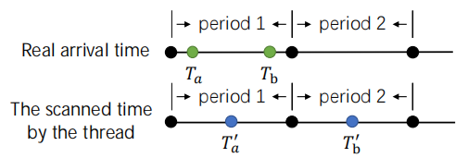
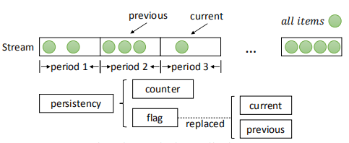
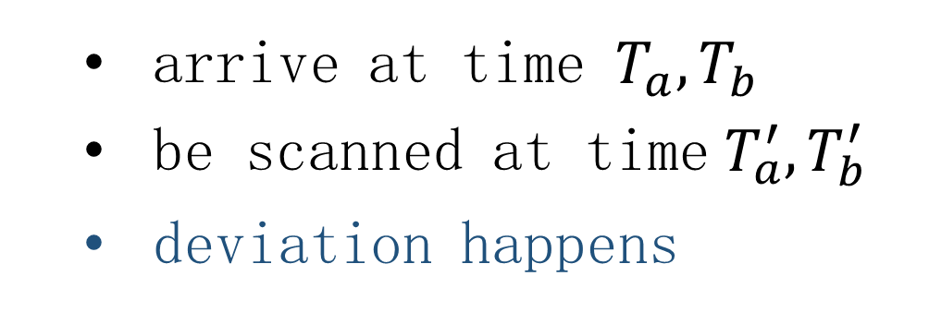
05
Optimizations---Deviation Eliminator
Deviation:
Deviation Eliminator:
arrive at time $T_{a}{,T}_{b}$
be scanned at time$T_{a}^{′}{,T}_{b}^{′}$
deviation happens
replace with two flags
when an item arrives, update the current flag
use the previous flag to update the counter
Notes:
First, using our strategy might cause a deviation from the real period. As shown in this slide, for an item, if it arrived at time Ta and Tb, but the corresponding time slot was scanned at time Ta’ and Tb’, the counter would be incremented twice. The reason behind is that this time slot has a deviation from the real period. Here is our solution, we replace the flag with two flags: the current flag denotes whether the recorded item has appeared in the current period, and the previous flag denotes whether the recorded item has appeared in the previous period. When an item arrives, we update the current flag, when a time slot is scanned, we use the previous flag of the corresponding cell to update the counter. In this way, the deviation is eliminated.

Slide 19
06
PART SIX
Experimental results
Notes:
Next, we present experimental results

Slide 20
06
Experiments (Setup)
Datasets:
Social --- a real social network
Network --- a temporal network of interactions
CAIDA --- from CAIDA Anonymize Internet Trace 2016
Dataset | # items | # periods
Social | 1.5M | 200
Network | 10M | 1000
CAIDA | 10M | 500
Notes:
This is the experimental setup.
We use three datasets: social, network and CAIDA.
As shown in the table, each dataset has different number of periods and more than 1 million items.

Slide 21
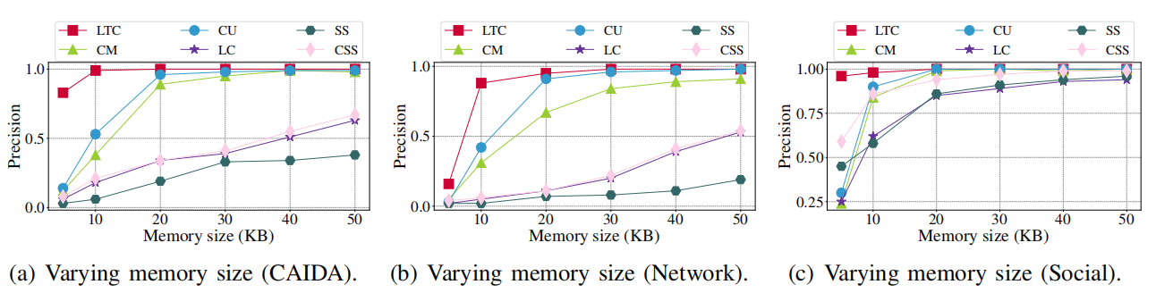
06
Experiments (Finding frequent items)
For finding frequent items, the precision of our algorithm is always higher than others.
Notes:
We first conduct experiments to compare our algorithm with related works for finding frequent items. Our algorithm works by setting alpha to 1 and beta to 0.
The red curve in this slide denotes our algoirithm .The results show that the performance our algorithm is much better than others.

Slide 22
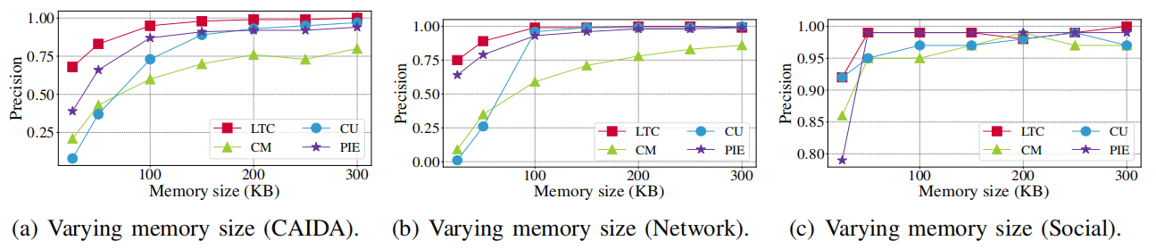
06
Experiments (Finding persistent items)
For finding persistent items, the precision of our algorithm is always higher than others.
Notes:
We also conduct experiments to compare related works for finding persistent items. Similarly, our algorithm works by setting alpha to 0 and beta to 1.
The results also show that the performance our algorithm is much better than others.

Slide 23
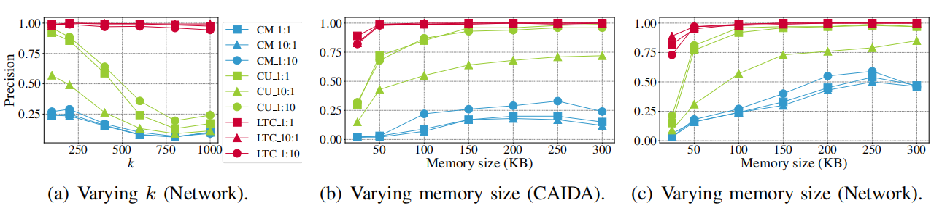
06
Experiments (Finding significant items)
For finding significant items, the precision of our algorithm is always higher than others.
Notes:
Finally, we conduct experiments to compare related works for finding significant items. The baselines are the CM sketch and the CU sketch. As I said before, for sketches, we use a counting bloom filter to make sure every item contributes at most 1 in one period. As shown in the slide, the first number denotes alpha, and the second number denotes beta. We can also observe that the performance of our algorithm is much better than sketches.

Slide 24
07
PART SEVEN
Conclusion
Notes:
Next, we present the conclusion.

Slide 25
07
Conclusion
1) Define a new issue: finding significant items
2) LTC: accurately find significant items with small memory size
3) Key techniques: Long-tail Replacement and a Clock with Deviation Eliminator
4) Experimental results: the performance of our algorithm is much better than related algorithms
Notes:
We first define a new issue: finding significant items
Then we propose a solution to accurately find significant items with small memory size
The key techniques are long-tail Replacement and a Clock with Deviation Eliminator.
The results show that the performance of our algorithm is much better than related algorithms

Slide 26
THANKS
Source code: https://github.com/Finding-Significant-Items/Finding-Significant-Items
Haowei Zhang
Peking University, China
Email: haowei.zhang@pku.edu.com
Notes:
Thanks.

